Slide 1
PHP - Lecture 8
Post Back, Radio Buttons and Check Boxes

Slide 2
Post Back
The Action attribute is crucial. It means, "Where do you want the form sent?". If you miss it out, your form won't get sent anywhere. You can send the form data to another PHP script, the same PHP script, an email address, a CGI script, or any other form of script.
In PHP, a popular technique is to send the script to the same page that the form is on – send it to itself, in other words. We'll use that technique now.

Slide 3
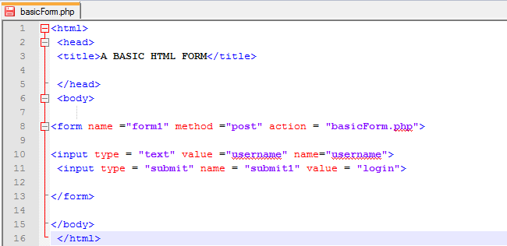
So you need to change the form action you have been creating in the past.
So we're going to be sending the form data to exactly the same page as the one we have loaded – to itself. We'll put some PHP on the page to handle the form data.

Slide 4
The HTML Submit button is used to submit form data to the script mentioned in the action attribute. Here's ours:
<form fame ="form1" method =“post" action = "basicForm.php">
So the page mentioned in the action attribute is basicForm.php. To Submit this script, you just need a HTML Submit button:
<input type = "submit" name = "submit1" value = "Login">
You don't need to do anything special with a Submit button – all the submitting is done behind your back.
As long as submit has an action set, then your data will get sent somewhere. But the name attribute of the Submit button comes in very handy.
You can use this name to test if the form was really submitted, or if the user just clicked the refresh button. This is important when the PHP script is on the same page as the HTML form. Our Submit button is called “submit1", but you can call it almost anything you like.

Slide 5
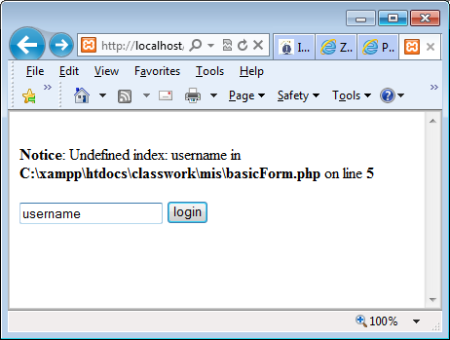
Add the following PHP script to the HTML code you have so far. Make sure to add it the HEAD section of your HTML .
<?php
$username = $_POST['username']; echo $username;
?>

Slide 6
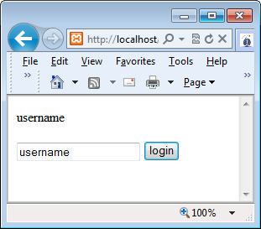
Save your work again, and click the submit button to run your script. (Don't worry if you see an error message about "Undefined index". Click the button anyway.) You should see this appear above your text box:

Slide 7
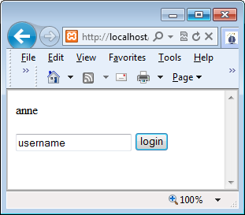
Delete the text "username" from the textbox, and click the button again.
Your new text should appear above the textbox. The textbox itself, however, will still have "username" in it.
This is because the textbox is getting reset when the data is returned to the browser.
The value attribute of the text box is what is being displayed.

Slide 8
At the moment, all we're doing is returning what the user entered and printing it to the page.
But we can use a bit of Conditional Logic to test what is inside of the variable.
As an example, change your PHP to this:

Slide 9
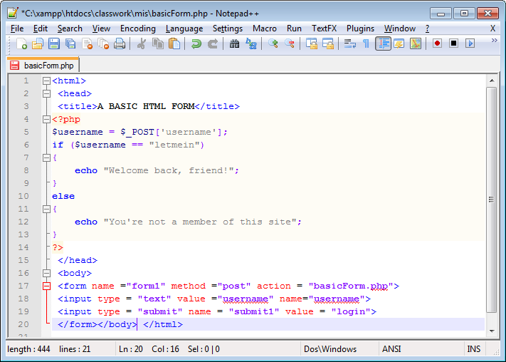

Slide 10
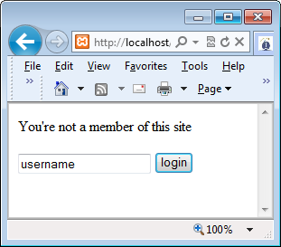
We're now checking to see if the user entered the text "letmein". If so, the username is correct; if not, print another message.
Try it out an see what happens. When you first load the page, before you even click the button, you might see the text "You're not a member of this site" displayed above the textbox.
That's because we haven't checked to see if the Submit button on the form was clicked.

Slide 11
The reason why the text displays when the page is first loaded is because the script executes whether the button is clicked or not. This is the problem you face when a PHP script is on the same page as the HTML, and is being submitted to itself in the action attribute.
To get round this, you can do a simple check using another IF Statement. What you do is to check if the Submit button was clicked. If it was, then run your code. To check if a submit button was clicked, use this:
if ( isset( $_POST[‘submit1'] ) ) { }

Slide 12
Now that looks a bit messy! But it actually consists of three parts:
if ( ) { } isset( ) $_POST['Submit1']
You know about the if statement.
But in between the round brackets, we have isset( ).
This is an inbuilt function that checks if a variable has been set or not.
In between the round brackets, you type what you want isset( ) to check.
For us, this is $_POST['Submit'].
If the user just refreshed the page, then no value will be set for the Submit button.
If the user did click the Submit button, then PHP will automatically return a value. Change you script to look like the following.

Slide 13
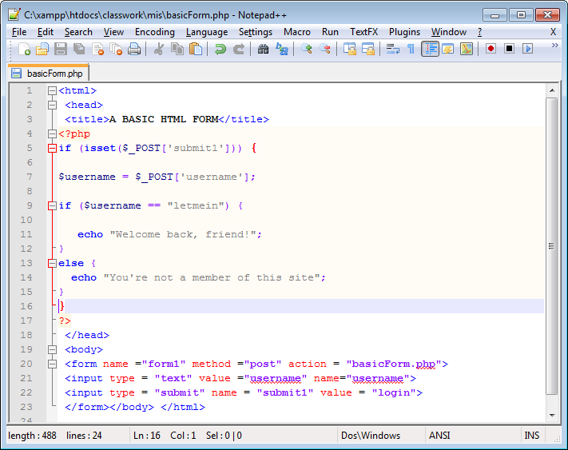

Slide 14
PHP Data Retention
You've learned how to get the text from a text box on a form, but there is a problem.
When the basicForm.php form is submitted, the details that the user entered get erased. You're left with the value that was set in the HTML.
For us, username keeps appearing in the textbox when the button was clicked. You can keep the data the user entered quite easily.
If you look at the value attribute of the textbox in the HTML from the above script, you'll see that it's set to "username".
Because the form gets posted back to itself, this value will keep re-appearing in the textbox when the page is submitted. Worse, if you've left the value attributes empty then everything the user entered will disappear. This can be very annoying, if you're asking the user to try again.
Better to POST back the values that the user entered.

Slide 15
To post the details back to the form, and thus keep the data the user has already typed out, you can use this:
value="<?PHP echo $username ; ?>"
In other words, the value attribute is now a PHP line of code. The line of code is just this:
<?PHP
echo $username ;
?>
Run the file, you should get an undefined error when the page is first displayed. Why? Can you fix it?

Slide 16
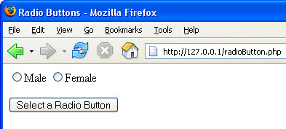
Radio Buttons
A Radio Button is a way to restrict users to having only one choice. Examples are : Male/Female, Yes/No, or answers to surveys and quizzes.
Here's a simple from with just two radio buttons and a Submit button:

Slide 17
To get the value of a radio button with PHP code, again you access the name attribute of the HTML form elements.
In the HTML above, the name of the Radio buttons is the same – "gender".
The first Radio Button has a value of "male" and the second Radio Button has a value of “female”.
When you're writing your PHP code, it's these values that are returned. Here's some PHP code. Add it to the HEAD section of your HTML:
<?PHP
$selected_radio = $_POST['gender']; echo $selected_radio;
?>

Slide 18
This is more or less the same code as we used for the textbox! The only thing that's changed (apart from the variable name) is the name of the HTML form element we want to access – "gender".
The last line just prints the value to the page.
Again, though, we can add code to detect if the user clicked the Submit button. This is the same code you saw earlier. Try it.

Slide 19
What you will notice, however, when you try out the code is that the dot disappears from your selected radio button after the Submit is clicked.
Again, PHP is not retaining the value you selected. The solution for radio Buttons, though, is a little more complex than for textboxes
Radio buttons have another attribute - checked or unchecked.
You need to set which button was selected by the user, so you have to write PHP code inside the HTML with these values - checked or unchecked. Here's one way to do it:

Slide 20
The PHP code:
<?PHP
$male_status = 'unchecked'; $female_status = 'unchecked';
if (isset($_POST['Submit1'])) {
$selected_radio = $_POST['gender'];
if ($selected_radio = = 'male') {
echo $selected_radio;
$male_status = 'checked';
} else if ($selected_radio = = 'female') {
echo $selected_radio;
$female_status = 'checked';
}
}
?>
The HTML FORM code:
<form name ="form1" method ="post" action ="radioButton.php">
<Input type = 'Radio' Name ='gender' value= 'male' <?PHP echo $male_status; ?> >Male
<Input type = 'Radio' Name ='gender' value= 'female' <?PHP echo $female_status; ?> >Female
<p> <Input type = "Submit" Name = "Submit1" VALUE = "Select a Radio Button">
</form>

Slide 21
Have a look at the PHP code inside the HTML first:
<?PHP echo $female_status; ?>
This is just a print statement. What is printed out is the value inside of the variable. What is inside of the variable will be either the word "checked" or the word "unchecked". Which it is depends on the logic from our long PHP at the top of the page. Let's break that down.
First we have two variables at the top of the code:
$male_status = 'unchecked'; $female_status = 'unchecked';
These both get set to unchecked. That's just in case the page is refreshed, rather than the Submit button being clicked.

Slide 22
Next we have our check to see if Submit is clicked:
if (isset($_POST['Submit1'])) {
}
Exactly the same as before. As is the next line that puts which radio button was selected into the variable:
$selected_radio = $_POST['gender'];
We then need some conditional logic. We need to set a variable to "checked", so we have an if, else … if construction:
if ($selected_radio == 'male') {
} else if ($selected_radio == 'female') {
}

Slide 23
All we're doing is testing what is inside of the variable called $selected_radio. If it's 'male' do one thing; if it's 'female', do another. But look at what we're doing:
if ($selected_radio == 'male') {
$male_status = 'checked';
} else if ($selected_radio = = 'female') {
$female_status = 'checked';
}
If the 'male' button was clicked then set the $male_status variable to a value of 'checked'. If the 'female' option button was clicked then set the $female_status variable to a value of 'checked'.
So the code works because of the values inside of two variables: $male_status and $female_status.
Yes, the code is very messy – but radio Buttons can be a quite tricky, when you want to retain the value of the selected item.

Slide 24
Try this
Create a form that takes in a wage through a text box and select the rate of tax from one of two radio buttons – 22% or 42%.
When a calculate button is pressed the result should be displayed in another textbox and the initial wage should still appear in the first textbox.

Slide 25
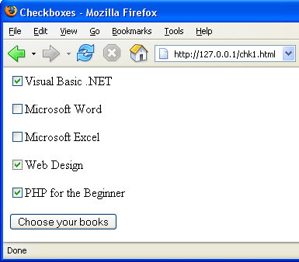
CheckBox
Like Radio buttons, checkboxes are used to give visitors a choice of options.
Whereas Radio Buttons restrict users to only one choice, you can select more than one option with Checkboxes.
Here's a page that asks users to choose which course books they want to order:

Slide 26
As you can see, five items can be selected.
Only three are chosen at the moment. When the button is clicked you, as the programmer, want to do at least two things: record which checkboxes were ticked, and have PHP "remember" which items were chosen.
You don't want the ticks disappearing from the checkboxes, if the user has failed to enter some other details incorrectly. We saw with Radio Buttons that this can involve some tricky coding. The same is true for checkboxes.
Show file……………

Slide 27
Note one thing about the HTML checkbox elements: they all have different name values (ch1, ch2 ch3, etc). When we coded for the Radio Buttons, we gave the buttons the same name. That's because only one option can be selected with Radio Buttons.
Because the user can select more than one option with Checkboxes, it makes sense to give them different name values, and treat them as separate entities.
In your PHP code, the technique is to check whether each checkbox element has been checked or not. It's more or less the same as for the radio Buttons. First we set up five variable and set them all the unchecked, just like we did before:
$ch1 = 'unchecked'; $ch2 = 'unchecked'; $ch3 = 'unchecked'; $ch4 = 'unchecked'; $ch5 = 'unchecked';

Slide 28
The next thing is the same as well: check to see if the Submit button was clicked:
if (isset($_POST['Submit1'])) {
}
Inside of this code, however, we have another isset( ) function:
if ( isset($_POST['ch1']) ) {
}
This time, we're checking to see if a checkbox was set. We need to do this because of a peculiarity of HTML checkboxes.
If they are not ticked, they have no value at all, so nothing is returned! If you try the code without checking if the checkboxes are set, then you'll have to deal with a lot of "Undefined" errors.

Slide 29
If the checkbox is ticked, though, it will return a value. And so the isset( ) function will be true. If the isset( ) function is true, then our code inside of the if statement gets executed:
if ($ch1 == 'net') {
$ch1 = 'checked';
}
This is yet another If Statement! But we're just checking the value of a variable. We need to know what is inside of it. This one says, "If the value inside of the variable called $ch1 is 'net' then execute some code.
The code we need to execute is to put the text 'checked' inside of the variable called $ch1. The rest of the if statements are the same – one for each checkbox on the form.

Slide 30
The last thing we need to do is to print the value of the variable to the HTML form:
<Input type = 'Checkbox' Name ='ch1' value ="net" <?PHP echo $ch1; ?> >Visual Basic .NET
Again, this is the same code you saw with the Radio Buttons. The PHP part is:
<?PHP echo $ch1; ?>
So we're just printing what is inside of the variable called $ch1. This will either be "unchecked" or "checked",
There are other solution for checkboxes, but none seem simple! The point here, though, is that to get the job done we used Conditional Logic.
Another way to deal with checkboxes, though, is with some JavaScript.

Slide 31
Try this
Create a form that calculates the cost of a flight. You enter the basic flight cost through a textbox, and then you can decide to add insurance, check in baggage or priority boarding using checkboxes.
Display the total cost of the flight in a textbox when a button is clicked. Again have all the controls retain their values.

